Slide 1

Artificial Intelligence for Business Decisions and Transformation
CSCN8030 - Spring 2024 - Section 2
Sprint 5 - Design
July 15, 2024
Group 4 - Members:
Krishna Kumar, Hemasree
Shijin, Jency
Fernandez, Arcadio
Professor:
Glaucia Melo dos Santos, PhD

Slide 2
Agenda
1. Group members role
2. Ideas
3. Dataset
4. Our focus
5. Project Pitch
6. Sprint Planning

Slide 3
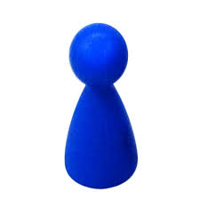

1. Group members role
Product owner
Developers
Hema
Arcadio
Jency
Connects with the customer
Contributes to the vision and roadmap
Manages and prioritizes the team backlog
Supports the team in delivering value
Continuously evolves product design
Implements the vision and roadmap
Works on the team backlog
Builds, tests, and delivers increments of value

Slide 4

2. Ideas
1. Influencer Growth Prediction
Project Idea: Build a predictive model to identify influencers who have the potential to transition from micro-influencers to macro-influencers.
Techniques: Supervised learning (Random Forest, Gradient Boosting, Neural Networks), feature engineering.
Outcome: Predict potential growth trajectories of influencers, provide insights for influencer marketing strategies.
2. Influencer Segmentation
Project Idea: Segment influencers into different groups based on their engagement metrics, content type, and audience demographics.
Techniques: Clustering (K-means, DBSCAN), PCA for dimensionality reduction.
Outcome: Detailed segmentation of influencers, enabling targeted marketing and collaboration strategies.
3. User Interest Profiling based on TikTok Reviews
Project Idea: Develop a system to automatically identify and classify user interest profiles based on user reviews.
Techniques: Supervised learning, sentiment analysis
Outcome: This will help in understanding user preferences, improving content recommendations, and aiding influencers in tailoring their content strategies

Slide 5
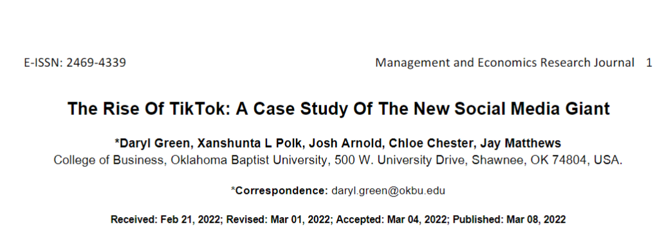
2. Ideas
STRENGTHS:
TikTok entered the market after the fall of Vine, a once-popular performance video uploading format (See Figure1). TikTok took advantage of Vine's failures and improved them; Offering longer videos and more options, including filters, music,and sounds, played a role in TikTok's rise. Another strength is TikTok's predominantly young workforce, which has helped create a platform that appeals to an audience of its young peers. The average age of TikTok users is between 16 and 24 (Wallaroomedia.com, 2021).
4.1.1. WEAKNESSES:
While influencers are a driving force of TikTok, they can cause issues because the company is not in control of the trends. Businesses often look to Porter's Five Forces, more specifically buyer power, to evaluate their relationships with customers, influencers in the case of TikTok. Buyer power is strongest when customers are organized, concentrated, and well-informed, and when the business's products and services are undifferentiated (Green and McCann, 2020). The influencer market is highly concentrated and well-informed about current trends, and the services are undifferentiated. However, influencers who do differentiate are the most successful on TikTok. A unique characteristic of social media platforms is that users, including influencers, mainly control what is posted. Therefore influencers, not TikTok, control the trends that appear on the platform. TikTok must effectively monitor the platform and influencers, or they risk losing customer connections, thus decreasing market advantages

Slide 6
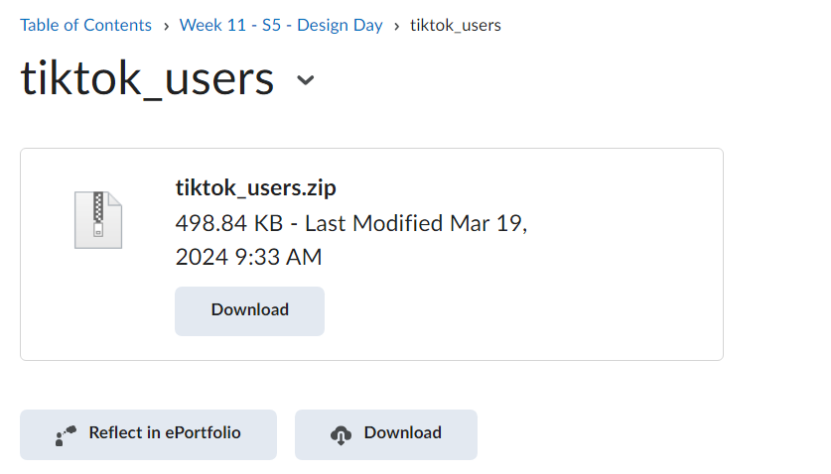
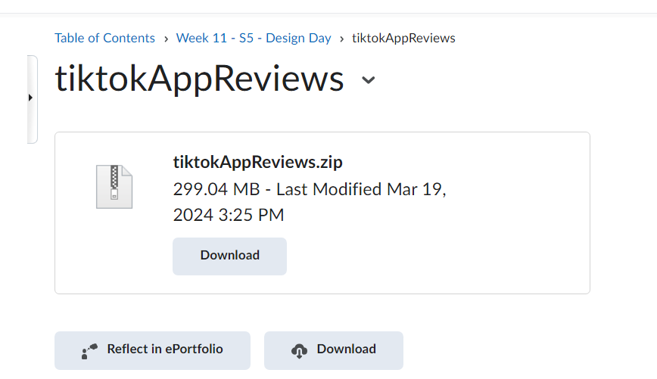
3. Analyzing the Dataset

Slide 7
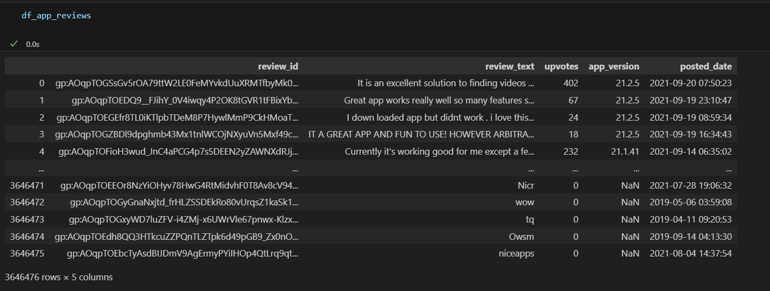
3. Analyzing the Dataset

Slide 8
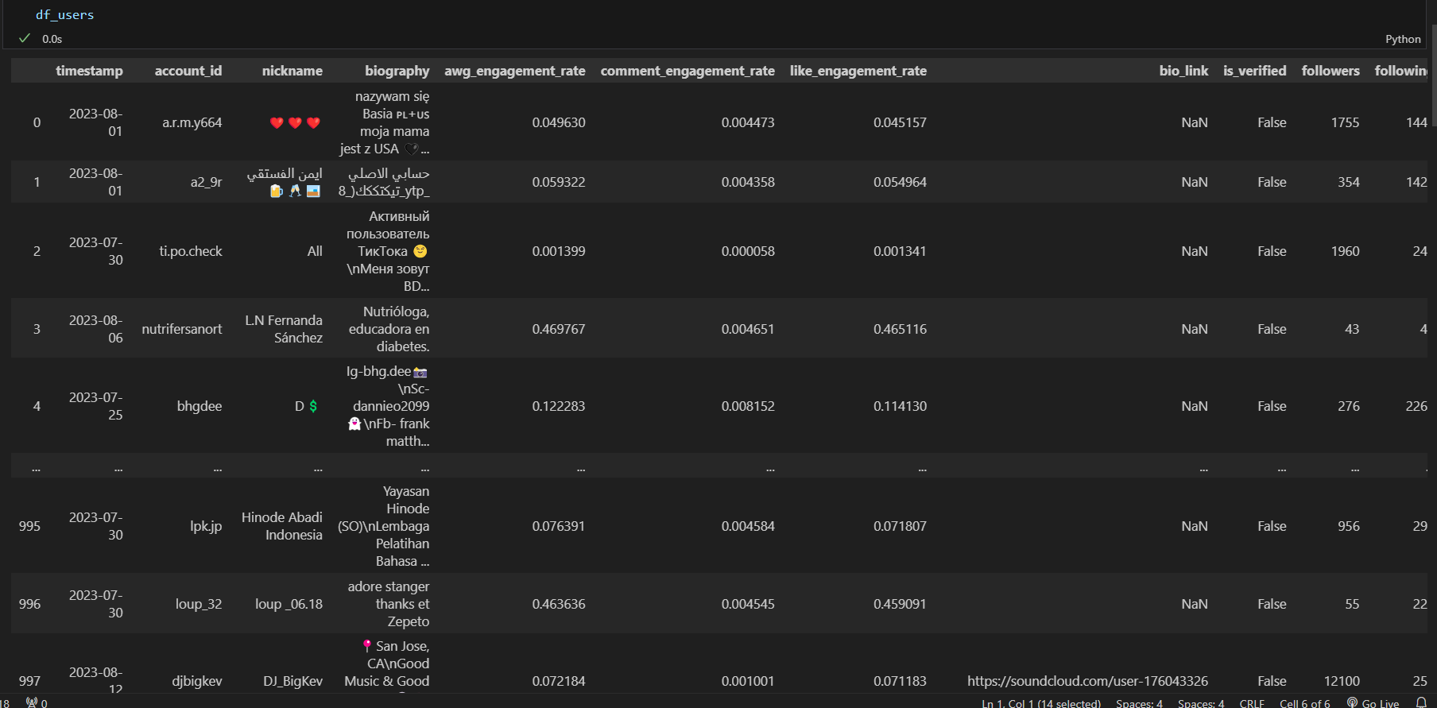
3. Analyzing the Dataset

Slide 9
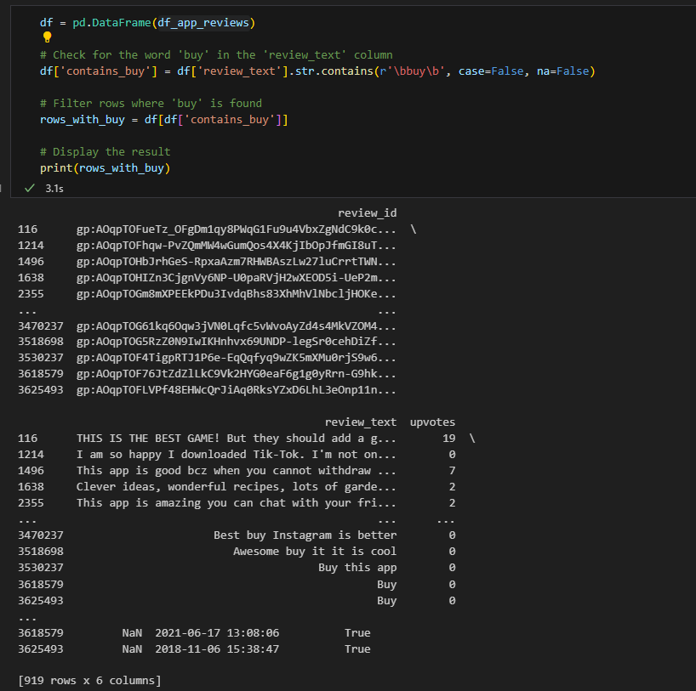
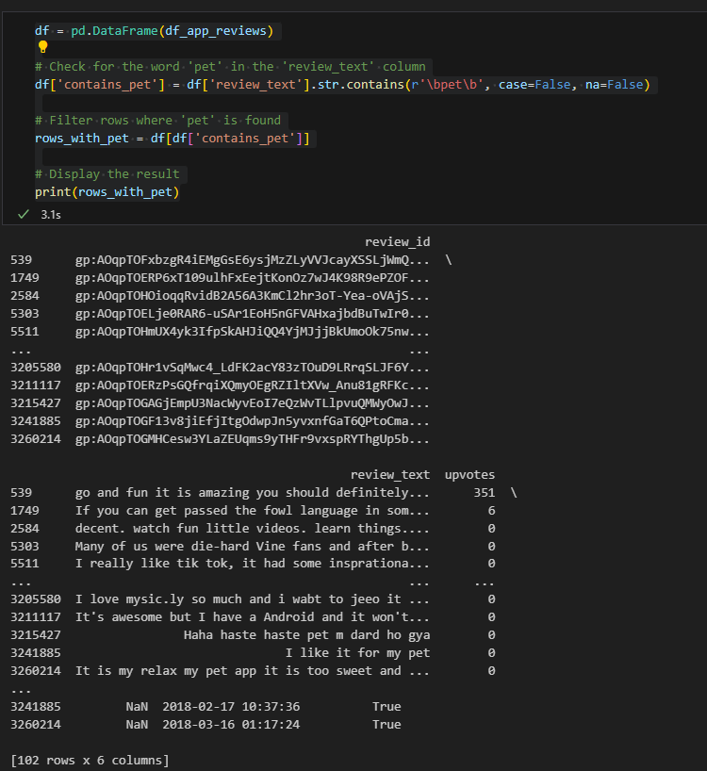
3. Analyzing the Dataset

Slide 10
4. Our focus
User Interest Profiles
Entertainment Enthusiasts: Users who are primarily interested in entertaining and humorous content.
Educational Seekers: Users who prefer content that provides knowledge or skills.
Lifestyle Admirers: Users interested in lifestyle content such as fashion, travel, and daily routines.
Fitness Fans: Users who engage with content related to health, fitness, and wellness.
Tech Savvy: Users who follow content about technology, gadgets, and innovations.
Foodies: Users who are interested in food, recipes, and cooking content.
DIY & Craft Lovers: Users who enjoy do-it-yourself projects, crafting, and creative activities.
Music & Dance Aficionados: Users who are passionate about music and dance content.
Gaming Enthusiasts: Users who are into gaming content, including gameplay, reviews, and live streams.
Beauty & Fashion Followers: Users who follow beauty tips, makeup tutorials, and fashion trends.
Pet Lovers: Users who enjoy content related to pets and animals.
Sports Fans: Users interested in sports-related content and athletic activities.

Slide 11
4. Our focus
1. Influencer Growth Prediction
Project Idea: Build a predictive model to identify influencers who have the potential to transition from micro-influencers to macro-influencers.
Techniques: Supervised learning (Random Forest, Gradient Boosting, Neural Networks), feature engineering.
Outcome: Predict potential growth trajectories of influencers, provide insights for influencer marketing strategies.
2. Influencer Segmentation
Project Idea: Segment influencers into different groups based on their engagement metrics, content type, and audience demographics.
Techniques: Clustering (K-means, DBSCAN), PCA for dimensionality reduction.
Outcome: Detailed segmentation of influencers, enabling targeted marketing and collaboration strategies.
3. User Interest Profiling based on TikTok Reviews
Project Idea: Develop a system to automatically identify and classify user interest profiles based on user reviews.
Techniques: Supervised learning, sentiment analysis
Outcome: This will help in understanding user preferences, improving content recommendations, and aiding influencers in tailoring their content strategies

Slide 12
5. Project Pitch
AI-Driven User Interest Profiling based on TikTok Reviews
Project Pitch | BUSINESS
Organization or Category | TikTok
Description of Organization | TikTok is a leading platform for short-form mobile videos. It allows users to create, share, and discover a wide variety of content, ranging from dance videos and comedy sketches to educational clips and personal vlogs. TikTok is known for its user-friendly interface, engaging content, and innovative use of artificial intelligence to recommend videos to users.
Two Specific Ethical Considerations in AI Adoption | 1. Privacy and Data Security Impact: If not managed properly, user data can be vulnerable to breaches, misuse, or unauthorized access. This can lead to a loss of trust among users, potential legal repercussions, and harm to individuals whose data is exposed or misused. 2. Manipulation and Misinformation Impact: This can lead to misinformation, where consumers are deceived about the quality or safety of a product, potentially causing financial loss, health risks, or other harms. It undermines the trustworthiness of the platform and can have significant repercussions for genuine businesses and consumers.

Slide 13
5. Project Pitch
AI-Driven User Interest Profiling based on TikTok Reviews
Three Examples of Operational Decisions | Content Recommendation - Increased user engagement and retention by providing personalized content that aligns with user interests. Marketing and Ad Targeting - Higher conversion rates and ROI on marketing campaigns by reaching users with relevant interests and needs. Content Creation and Curation - Boosted user engagement and content interaction by focusing on high-demand content areas and fostering a community around shared interests.
Three Examples of Tactical Decisions | Content Promotion- Launching a targeted advertising campaign for a new content category (e.g., educational content. TikTok can decide to promote specific types of content through paid advertising to attract more viewers and creators in that category. Algorithmic Adjustment for Regional Markets: Customizing the platform's algorithm to cater to regional preferences (e.g., promoting local music and dance trends in specific countries). This decision enhances user satisfaction and retention by providing culturally relevant content experiences. Real-Time Analytics : providing creators with actionable data about user interests and preferences helps them understand their audience better and create more compelling content, thereby driving increased user engagement and retention.

Slide 14
5. Project Pitch
AI-Driven User Interest Profiling based on TikTok Reviews
Three Examples of Strategic Decisions | Global Expansion : Based on market research and potential user base analysis, TikTok can expand its presence into new countries or regions. This decision aims to capitalize on global user growth opportunities, increase brand visibility, and diversify revenue streams. Partnerships and Collaborations with Media and Entertainment Industry: Partner with media and entertainment companies to boost user engagement by expanding content, securing music and video licenses, and reaching a wider audience through exclusive collaborations. Innovation in AR/VR Experiences: Innovations in AR/VR can attract tech-savvy users interested in immersive experiences, which may form a distinct interest profile. Understanding how users engage with AR/VR content versus traditional video content can refine the categorization of users based on their preferences.

Slide 15
5. Project Pitch
AI-Driven User Interest Profiling based on TikTok Reviews
Why this is topic important? | Personalized Content: AI-driven user interest profiling helps in delivering personalized content to users based on their preferences, behaviors, and interactions. This ensures that users see reviews and recommendations that are most relevant to their interests, leading to a more engaging and satisfying user experience. User Retention: By tailoring the content to individual interests, TikTok can increase user retention rates. Users are more likely to stay on the platform and interact with it frequently if they consistently find content that aligns with their tastes and preferences.
How could this project make an impact outside of class? | Successfully developing and implementing an AI-driven user interest profiling system can significantly enhance our professional portfolio. Demonstrating expertise in advanced AI techniques, data analysis, and real-world application can make us a strong candidate for roles in data science, AI development, and product management.
Why should class choose this topic? | Current Trends: Social media and content personalization are at the forefront of technological innovation. Understanding and leveraging AI in these areas can provide valuable, up-to-date knowledge and skills. Industry Demand: There is a high demand for professionals skilled in AI, data science, and user profiling. Working on this project can provide practical experience that is highly relevant to current job markets and future career opportunities.

Slide 16
6. Sprint Planning
Tasks | Owner | Priority | Sprint | Story Points | Estimated Effort in Hours
Perform Data integration by merging TikTok public user profiles and user reviews data by identifying common keys or fields. | Hema | med | 5 | 3 | 1
Clean the data by handling missing values, correcting data types, and ensuring data consistency. | Hema | med | 5 | 3 | 1
Explore the dataset to understand its structure, features, and distributions to gain insights into engagement patterns, identify trends or user interests | Hema | High | 5 | 5 | 1
Preprocess the user reviews or any other text data by cleaning, tokenizing, lemmatizing, and removing stop words. | Hema | High | 5 | 5 | 2
Convert the preprocessed text data into numerical representations using text embeddings such as BERT, FastText, or TF-IDF. | Jency | Med | 5 | 3 | 1
Utilize pre-trained models for text classification, such as BERT fine-tuned with Hugging Face’s Transformers library, to annotate user reviews into predefined interest profiles | Jency | Med | 5 | 3 | 1
Choose appropriate ML algorithms based on business objectives | Jency | Med | 5 | 3 | 1
Train and Fine-tune the selected models using a labeled dataset for specific interest profiles. | Arcadio | High | 5 | 5 | 2
Evaluate the model performance using metrics like accuracy, precision, recall, and F1-score. | Arcadio | High | 5 | 5 | 2
Interpret the user interest profiling results to identify trending topics and areas of user interest and preferences. | Arcadio | High | 5 | 3 | 3

Slide 17
Thank you
Any Questions

